Slide 1

Department of Artificial Intelligence and Data Science Dr. D Y Patil College of Engineering & Innovation Varale, Talegoan Pune, Affiliated to Savitribai Phule Pune University
Presentation on project topic Rewiew1
By
Following BE Students of Dep. Artificial Intelligence and data science
Coordinated by Prof. Suraj Bhoite
Group member names :
Vedant Sase (BE,Roll no: 24155)
Prasad Patil (BE,Roll no: 24152)
Sunny Gangurde (BE,Roll no: 24159)
Somesh Chaudhari (BE , Roll no: 24133)
Under the Guidance of Prof. Mrs. Asmita Mali

Slide 2
Abstract :
This project uses data on soil and weather conditions to provide personalized advice to farmers, helping them grow crops more efficiently and sustainably. By analyzing factors like soil nutrients, temperature, and rainfall, we can identify the best ways to manage crops, reduce waste, and promote healthy growth.

Slide 3
INTRODUCTION :
SmartAgri Advisor is a cuttingedge tool that empowers farmers with precise, datadriven crop recommendations. By leveraging AI, machine learning, and big data, it provides personalized advice on crop selection, cultivation practices, and resource management. This technology helps optimize resource use, enhance productivity, and promote sustainability, making it an essential tool for modern, sustainable agriculture.

Slide 4
RESEARCH GAP IDENTIFICATION :
Limited integration of soil and weather data:
Most existing research focuses on either soil or weather data, but not both.
Limited farmer adoption and user experience:
Many crop recommendation systems are not userfriendly or fail to account for farmer preferences.
Insufficient use of machine learning algorithms:
While machine learning is widely used in agriculture, its application in crop recommendation systems is still limited.

Slide 5
Problem Statement :
Nowadays because of unpredictable weather and market conditions it is difficult for farmers to choose, manage their yields, to solve this problem we are presenting a software which will consider and solve above problems.

Slide 6
AIM AND MOTIVATION :
Our aim is to increase crop yields, reduce environmental impact, and support farmers in making datadriven decisions. This approach can help meet the world's growing food demands while protecting the planet.

Slide 7
SCOPE AND MOTIVATION :
Scope:
Explore how soil and weather data can improve crop management.
Bridging the gap where it Connect farmers, researchers, and technology to promote sustainable agriculture.
Objectives:
Develop a system that provides personalized crop recommendations to farmers.
Create a userfriendly platform for farmers to make datadriven decisions.
Advance our understanding of how soil, weather, and crops interact.
Share findings to benefit farmers and the environment global.

Slide 8
Literature Review :
Sr. no | Paper Details | Problem Discussion | Algorithm /Technique used | Parameter Consider | Result
3 | Robust Smart Irrigation System using Hydroponic Farming based on Data Science and IoT By Punya Prabha , Sarala S , Sharmila Suttur | Manual Labor Dependence, Water Inefficiency, Space Requirements, Lack of Technological Integration, Inefficient Resource Management, Climate Dependency | IoT Architecture, Hydroponic System Design, Sensor Integration, Raspberry Pi and IoT Communication, Machine Learning for Plant Growth Prediction, WebBased User Interface | Predictive plant health, Predictive Analytics Parameters, Environmental Parameters | This your study is centered around developing a smart, AIbased irrigation system that leverages the Internet of Things (IoT) to optimize water usage in agriculture
4 | Crop Recommendation using Machine Learning with Challenges and Future Ideas. By Devendra Dahiphale, Pratik Shinde, Koninika Patil, and Vijay Dahiphale. In 12062023 / 14062023 | The traditional process of crop recommendation relied heavily on expert knowledge, which was timeconsuming and laborintensive. With the global population expected to reach 9.7 billion by 2050. | Logistic Regression, Decision Tree, Random Forest, KNearest Neighbors, Naive Bayes, Support Vector Machine (SVM), Neural Network | Preprocessing the data (removing null and duplicate records, feature engineering). Choosing a machine learning algorithm and iterating through preprocessing to testing/validating the model. Configuring model parameters like activation functions, | The proposed system achieved nearperfect accuracy, consistently over 95% across all models. The comprehensive approach and feature engineering contribute significantly to the effectiveness of the crop recommendation system.

Slide 9
Literature review :
Sr. no | Paper Details | Problem Discussion | Algorithm /Technique used | Parameter Consider | Result
1 | IoT Based Smart Plant Irrigation System with Enhanced learning By Kemal Cagri Serdaroglu, Cem Onel | Static Models, Inefficiency in Water Use, Lack of Learning Mechanisms, Environmental Variability | Gradient Boosting Regression Trees (GBRT), Random Forest Regression, Support Vector Regression (SVR), Artificial Neural Networks (ANNs) | Environmental Parameters, PlantSpecific Parameters, System Parameters, Machine Learning Parameter | This study presents a smart plant irrigation IoT system designed to autonomously adapt to specific irrigation habits by leveraging dynamic environmental data.
2 | IoTBased smart irrigation system using artificial intelligence By N. Rahul, S. Sumathi, S. Rajaprabu, J. Prawin Kumar | Inefficiencies in Traditional Irrigation Practices, Water Scarcity and Resource Management, Lack of RealTime Monitoring and DecisionMaking | Data Collection and Preprocessing, Predictive Modeling, DecisionMaking Algorithms | IoT Sensor Parameters, AI and Predictive Analytics Parameters, System Performance Metrics, Deployment and Scalability Parameters, Economic and Environmental Impact | In modern agriculture, networking technology has become vital for efficient farm management. The advent of the Internet of Things (IoT) has transformed traditional farming practices, allowing for realtime data collection and remote control of agricultural activities.

Slide 10
ROADMAP BUILDING :
Workflow Overview:
Input: Soil conditions, crop data, weather data, market scenarios. Process: Analytical and machine learning models to analyze data. Output: Recommendations for crop choices and market scenarios.

Slide 11
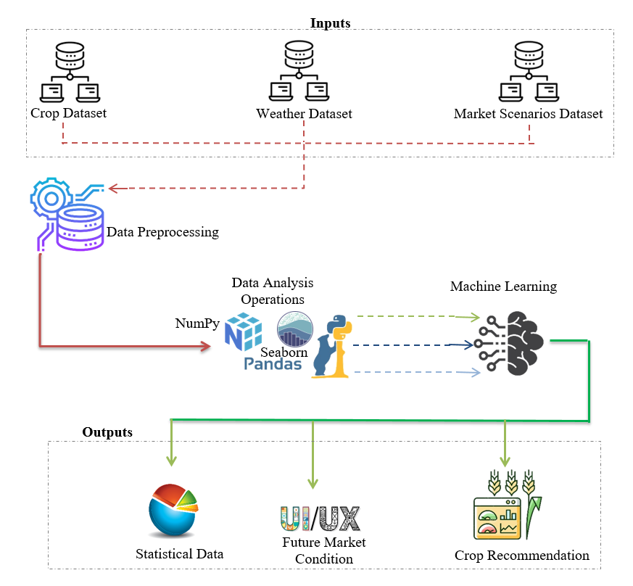
System Architecture Planning :
Architecture Overview
This workflow includes soil conditions, Crop data set from Agriculture Universities, weather data of that particular region, Market Scenarios are taken as input for different analytical and Machine learning models which provides a clean and clear data representation in form of statistical data. It mainly focuses on recommending crop and future market scenarios about yield cost and available stock.

Slide 12
System Architecture Planning :
Components:
Data collection
Data processing
Data analysis
Machine Learning
Recommendation modules.
System Requirements:
Software: Windows or Linux
Programming Languages : Python, Java Script / Node.js
Development Frameworks : Flask, TensorFlow.
Database : MySQL, MS-SQL, MongoDB, Apache Kafka.
Hardware: i5 Processor, 512 GB SSD, 8GB RAM.

Slide 13
Risk Identification :
1. Risk Identification :
In the face of growing challenges in modern agriculture, farmers need precise and sustainable methods to enhance crop yield while managing resources effectively.
2.Risk Analysis:
Data Accuracy: High impact, as incorrect data can lead to poor decisionmaking. It depends on the sources and methods of data collection.
Sensor Malfunction: Sensor failures could disrupt irrigation automation.
Market Volatility: Sudden market changes might reduce recommendation effectiveness.
Adoption Resistance: Farmers may be hesitant to adopt new technology.

Slide 14
Risk Mitigation: Ensure Data Quality: Implement validation techniques to ensure accurate data. Redundant Systems: Use backup sensors and manual overrides for irrigation. RealTime Updates: Regularly update market data to keep recommendations relevant. User Training: Provide training to encourage technology adoption by farmers. Monitoring and Management: Regular Audits and Diagnostics: Continuously monitor data and sensors. Market Reviews: Periodically review and update market data. Feedback Loops: Collect farmer feedback to improve the system. Contingency Planning: Prepare alternative strategies for identified risks.

Slide 15
Conclusion : - This is project review stage 2 and we have studied the requiredment analysis, requiredment gathering(hardware, software), source management, risk identification, risk analysis and finding solution on it.

